Slide 1
SWIES/IT Defence presentation
BY
Name : Ebisi chinecherem Leonard
martic number : NS/CSC/22/7428
Organization : kodex African
Apr 1TH - SEPTEMBER 31TH, 2025.

Slide 2
Kodex Africa (Summary)
Kodex Africa is a tech organization that trains and mentors young people in technology. Started in 2021 as Kodex Limited and has grown into a bigger and stronger tech community. The company helps people learn tech skills, build projects, and get real experience.They focus on empowering African youths and creating opportunities in the tech industry.Their goal is to support learning, innovation, and professional growth. Located at: No. 127, Iyiagu Housing Estate, Awka, Anambra, Nigeria.

Slide 3
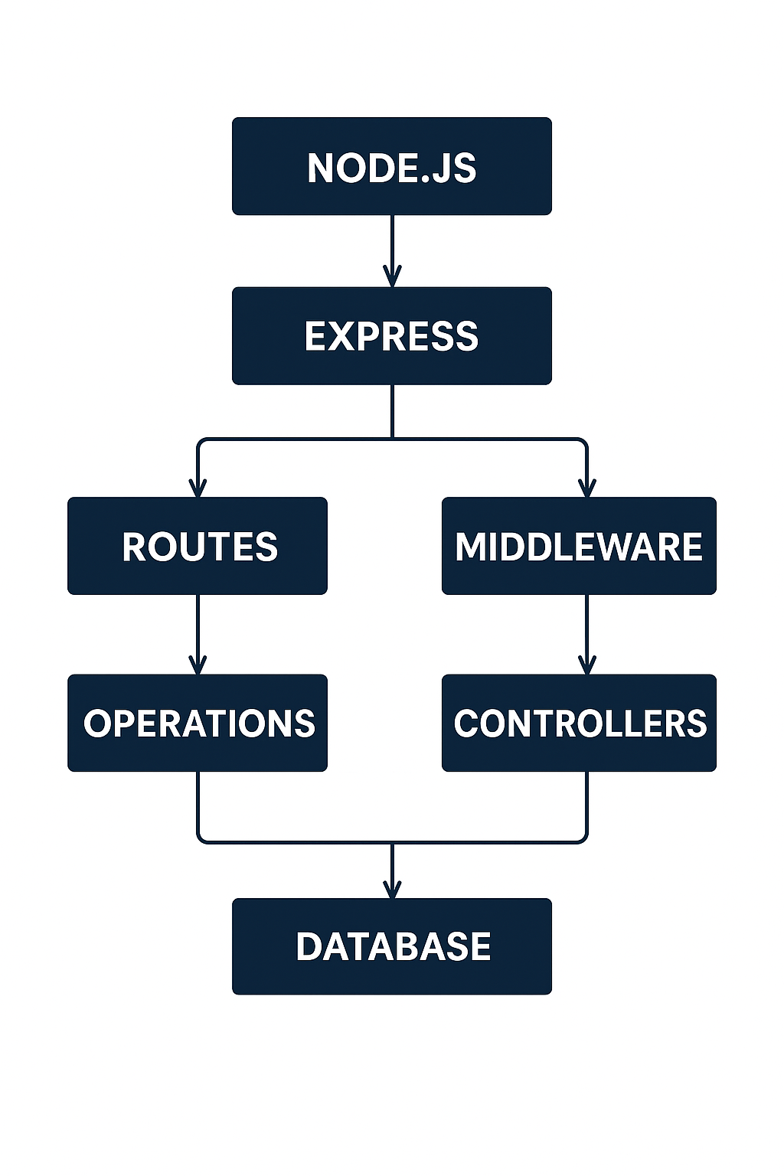
Experience Gathered (NODE JS, EXPRESS JS BACKEND && MongoDB)
During my Student Industrial Work Experience Scheme (SIWES) at Kodex African, Awka, I was privileged to undergo intensive training and practical exposure to backend development using modern web technologies such as Node.js, Express.js, MongoDB, APIs, and other essential backend tools.
The experience allowed me to move beyond theoretical knowledge and understand how real-world backend systems are structured, developed, and maintained.

Slide 4
Node.js
A JavaScript runtime that allows user to run JavaScript on the server, enabling you to build backend applications. It uses an event-driven, non-blocking I/O model for high performance.
Core Modules Practice:
fs (File System): Read, write, and manage files programmatically.
path: Handle and manipulate file paths safely.
os: Access system-related information like CPU, memory, and OS type.

Slide 5
Express.js
A lightweight framework for Node.js that simplifies building web servers and APIs by providing routing, middleware, and request/response handling.
Created RESTful APIs
Used middleware, routing, and request handling (req.body, req.params, req.query)
Implemented error handling and response formatting
Understanding middleware
Middleware in Express.js runs before the request reaches the route and before the response is sent. It can check, modify, or handle the request, then pass it along to the next function. Think of it like a chain of steps the request goes through before the final response.

Slide 6
MongoDB Database
MongoDB: NoSQL non-relational databases for storing JSON-like documents.
Mongoose: An Object-Relational Mapping (ORM) library for Node.js that connects your app to MongoDB.
Why Use Mongoose:
Defines schemas to structure your data.
Provides models to perform CRUD operations easily.
Includes built-in validation, hooks, and middleware.

Slide 7
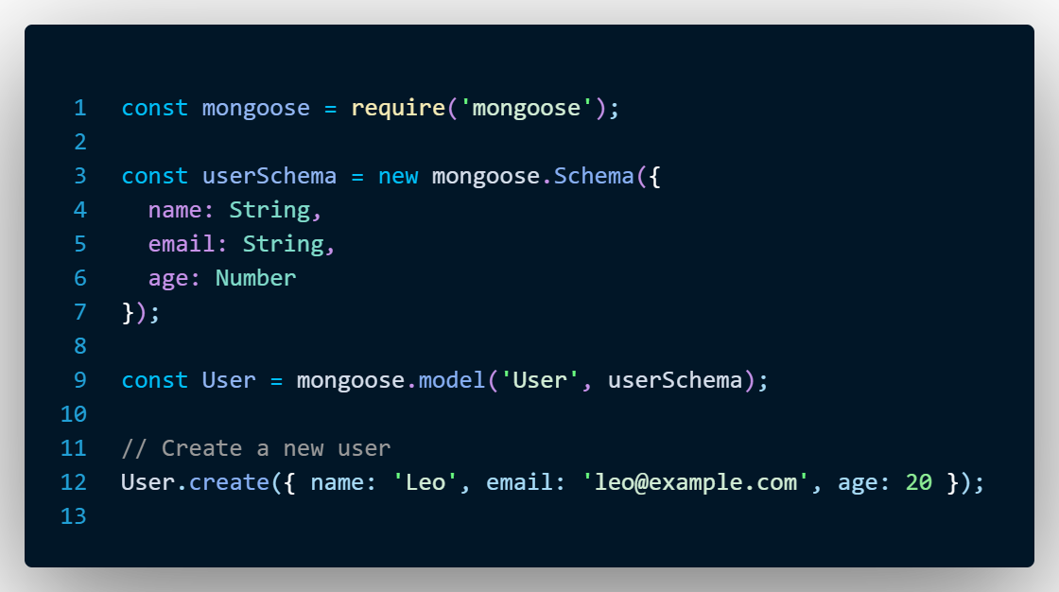
Using Mongoose ORM for database communication

Slide 8
Challenges Encountered During IT
Transportation & traffic issues – Difficulty reaching the IT location on time due to traffic delays.
Time constraints – Not enough time was given to complete some tasks properly.
Tight schedules – Balancing tasks and deadlines was challenging.
Network/internet issues

Slide 9
Conclusion
Summary of Skills Gained
Gained practical experience in Node.js, Express.js, MongoDB, and teamwork.
How IT Improved my Knowledge
Enhanced my problem-solving and project management skills.
Appreciation:
I sincerely appreciate Kodex AFRICA, my supervisor, and my school for this valuable
This experience has prepared me to contribute effectively in a professional tech environment.

Slide 10
Demonstration of IT Activities
Third week of the program: A task was given to build a To-Do web app with authentication.
GitHub repository: https://github.com/skido600/todotask.git
Project 2: I worked on a Bank API.
GitHub repository: https://github.com/skido600/bank_api.git
Project 3: I worked on a transport a p I, where user can book driver for local business,
GitHub repository: https://github.com/skido600/tranportapi.git

Slide 11
THE
END

